Slide 1
ML in NLP
Nume Student: DLarisa
Grupa: 341

Slide 2
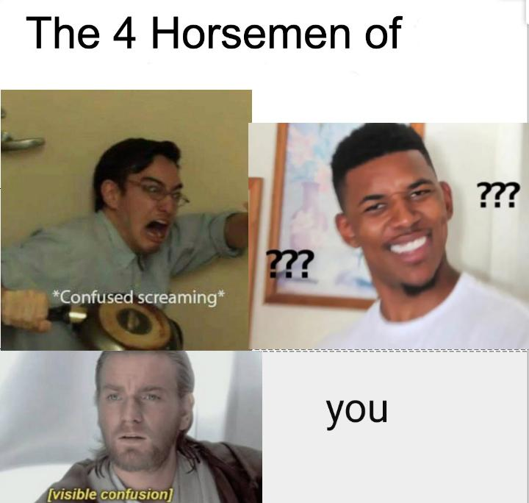
Introducere
AI?
ML?
DS?
Oricare 2 litere alaturate?
PS?
DL?
NLP?

Slide 3
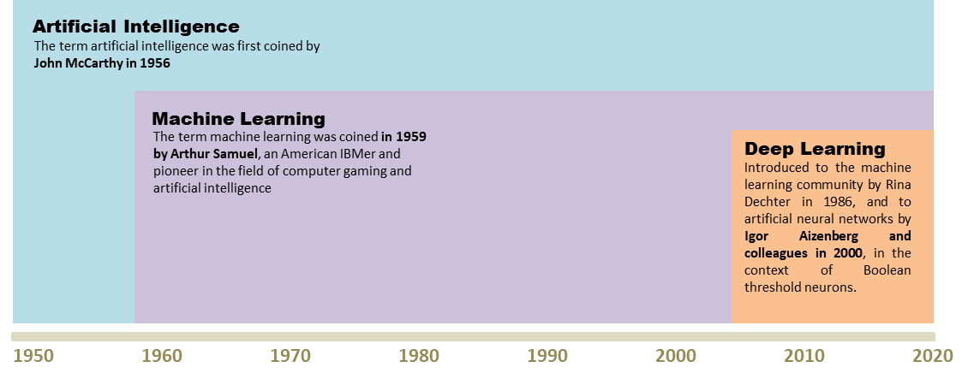
AI VS ML VS DL: Scurt Istoric

Slide 4
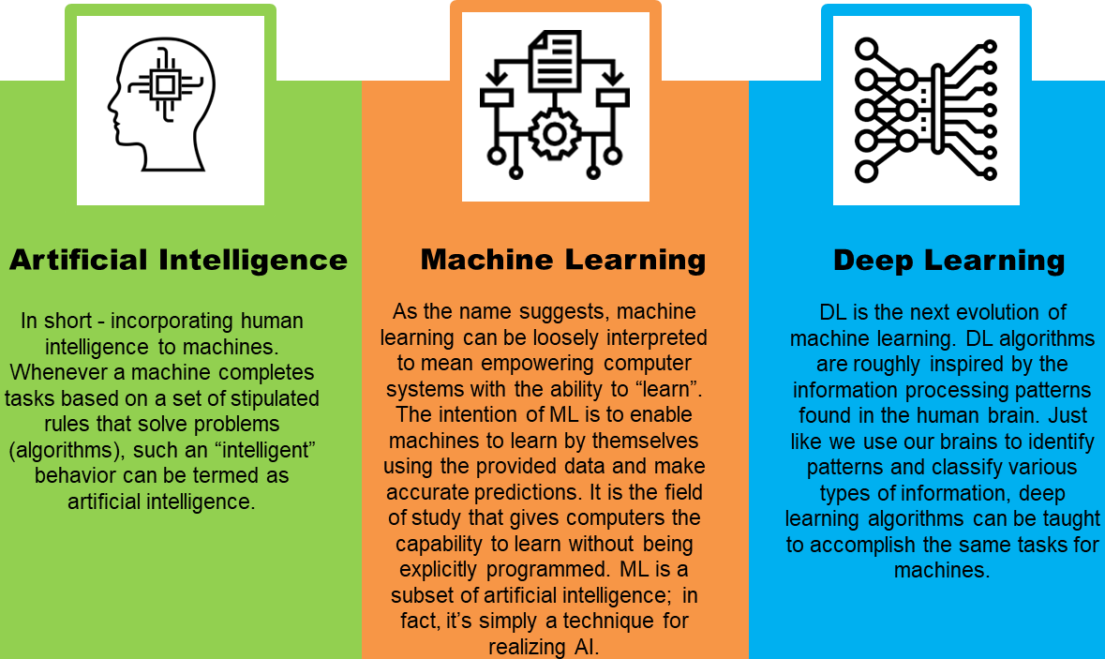
AI VS ML VS DL: Diferențe

Slide 5
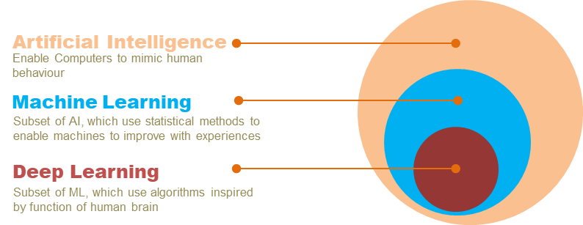
AI VS ML VS DL: Relații

Slide 6
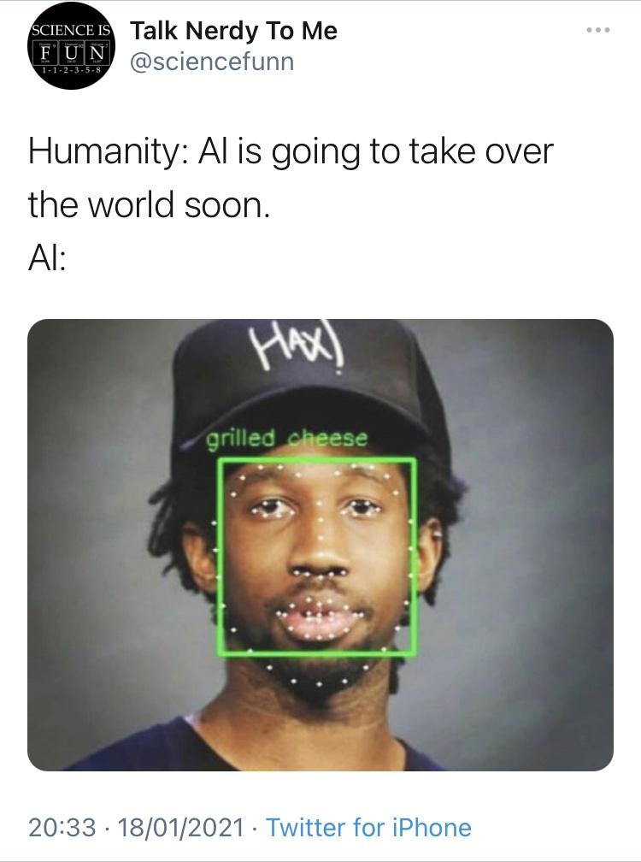

Domeniul Ai încă nu este suficient de... inteligent

Slide 7
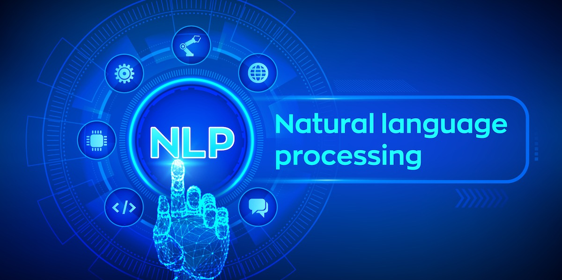
Nlp: ce este?

Slide 8
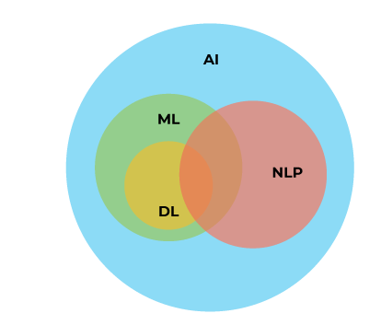
Nlp: raportul cu ai

Slide 9
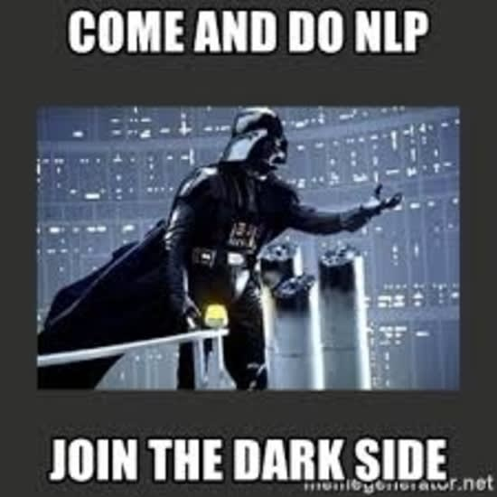
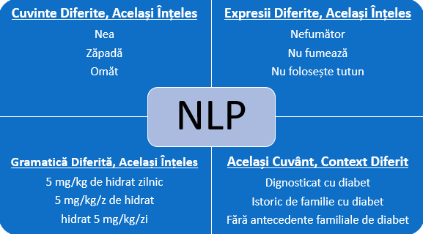
NLP: Probleme

Slide 10
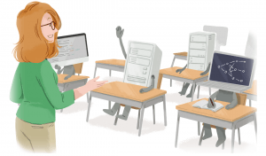
ML in NLP
Când se vorbește despre analiza textului, învățarea automată este considerată o combinație de tehnici statistice care servește la detectarea tiparelor, sentimentelor din spatele cuvintelor (furie, ironie, fericire etc...), părților de vorbire și altor fenomene dintr-un text.

Slide 11


Ml in nlp
Învățarea Supravegheată: În acest tip de învățare automată, o serie de documente text sunt etichetate sau adnotate cu exemple referitoare la ce ar trebui să caute mașina și cum ar trebui să interpreteze acel aspect. Aceste documente sunt utilizate pentru a antrena un model statistic, căruia i se oferă apoi un text neetichetat pentru a fi analizat. Cu cât setul de date este mai mare, cu atât rezultatele sunt mai bune: fiecare model poate fi instruit de mai multe ori pentru a-și îmbunătăți învățarea. Cei mai populari algoritmi din această categorie sunt: Support Vector Machines, Bayesian Networks, Maximum Entropy, Conditional Random Field, Neural Networks/Deep Learning.

Slide 12
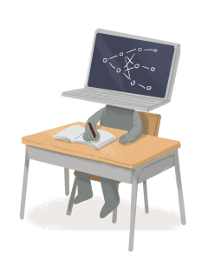
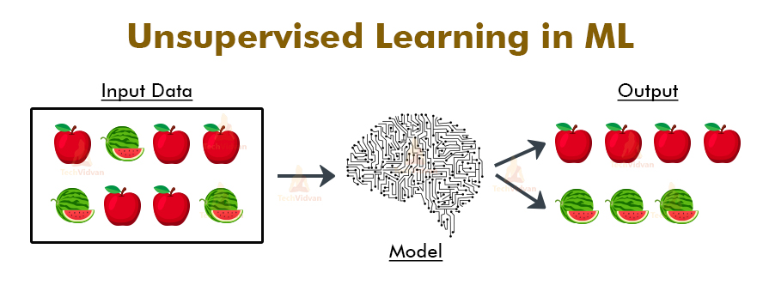
Ml in nlp
Învățarea Nesupravegheată: Acest tip implică instruirea unui model fără etichetare prealabilă sau adnotare. Unele dintre aceste tehnici sunt surprinzător de ușor de înțeles:
Clustering: înseamnă gruparea documentelor similare în grupuri sau seturi. Aceste clustere sunt apoi sortate în funcție de importanță și relevanță (grupare ierarhică).
Latent Semantic Indexing (LSI): e folosită pentru a obține acele cuvinte care apar adesea împreună în texte. Oamenii de știință utilizează LSI pentru căutări cu mai multe fațete sau pentru returnarea rezultatelor căutării care nu sunt termenul exact de căutare. Ex: dacă cuvintele „TV” și „canal” sunt corelate în multe texte, atunci veți primi foarte probabil documente care conțin „canal”, chiar dacă doar căutați „TV”.
Matrix Factorization: Această tehnică folosește „factori latenți” pentru a descompune o matrice mare în două matrici mai mici. Factorii latenți sunt asemănări între elemente. Ex: „Am aruncat mingea peste munte”. Cuvântul „aruncat” este asociat, mult mai probabil, cu „minge” decât cu „munte”.

Slide 13
How to Enhance Machine learning through NLP
Tokenization – Tokenizarea implică expresii regulate. În engleză, acest lucru se realizează ușor datorită spațiilor dintre cuvinte. În chineză, unde nu există spații, un algoritm adecvat și dicționare de înaltă calitate sunt cruciale pentru identificarea regulilor și tiparelor.
POS-Tagging - Part-of-Speech Tagging e utilizat pentru mai multe sarcini NLP, cum ar fi extragerea subiectului unui text sau identificarea părților de vorbire. Cele mai moderne tehnici folosite au obținut acuratețe de 90% chiar și când sunt folosite texte cu limbaj de argou sau limbaj folosit în social media.
Entity Extraction – După cum sugerează numele, aceasta este o tehnică de extragere a entităților (nume, locuri, numere de telefon etc...).
Sentiment Analysis – Se bazează pe identificarea opiniilor și sentimentelor umane indiferent de sursă (sondaje, recenzii, conversații etc...). Cum se realizează acest lucru? Mai întâi este identificat subiectul principal al textului introdus și apoi se face o evaluare a opiniilor exprimate în cadrul inputului, primimnd o notă pe scala pozitiv-negativ.
Categorization – Textele sunt clasificate în diferite categorii.

Slide 14
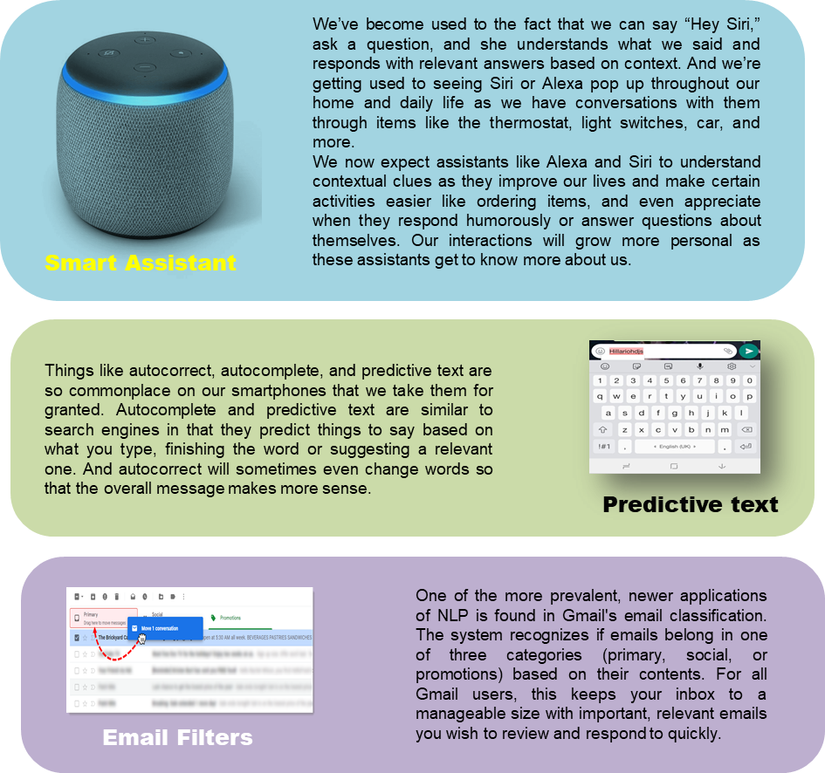
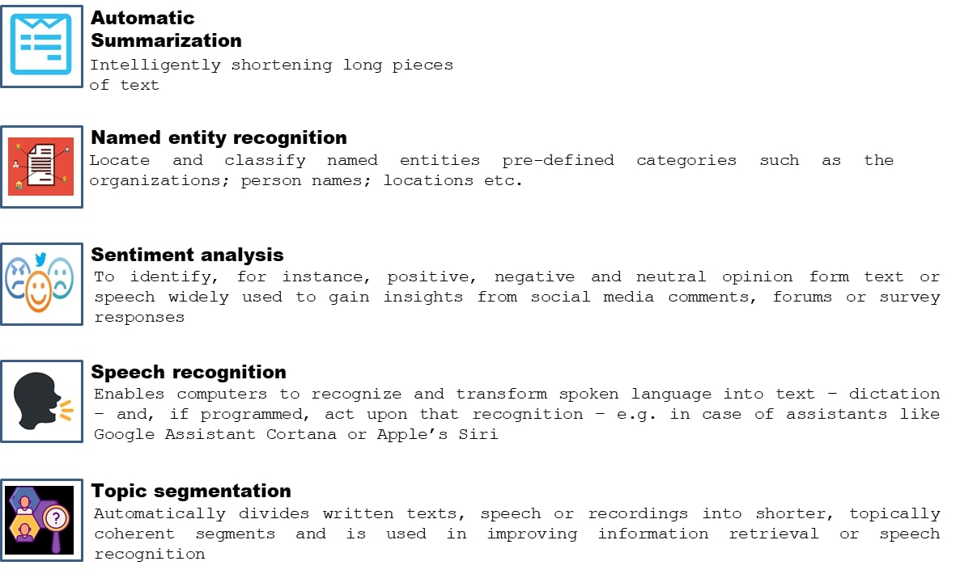
NLP: Game changers in our daily life, examples for Businesses

Slide 15
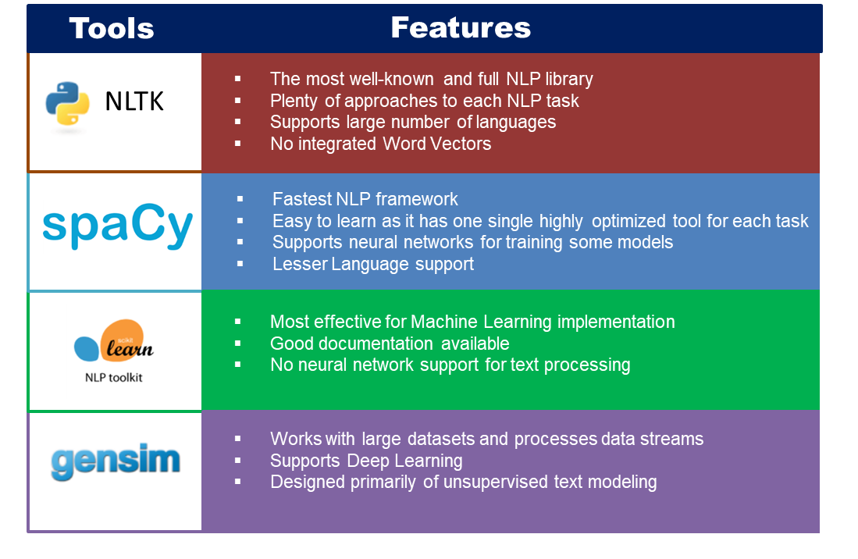
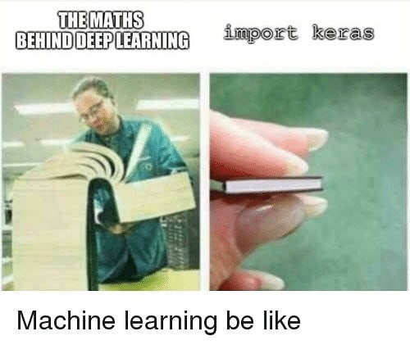
Widely used NLP Libraries

Slide 16
Din punctul de vedere al unei companii...
Advantages of NLP:
Once implemented, using NLP is less expensive and more time-efficient than employing a person.
NLP can also help businesses offer faster customer service response times. No matter the time of day or day of the week, customers receive immediate answers to their questions.
Pre-trained machine learning models are widely available for developers to facilitate different applications of NLP, making them easy to implement.
Disadvantages of NLP:
Training can be time-consuming. If a new model needs to be developed without the use of a pre-trained model, it can take weeks before achieving a high level of performance.
Another disadvantage of NLP is that ML is not 100 percent reliable. There is always a possibility of errors in predictions and results that need to be taken into account.

Slide 17
Ml and nlp research highlights of 2020
Multilinguality
What happened? 2020 had many highlights in multilingual NLP. New general-purpose benchmarks for other languages emerged including XTREME (Hu et al., 2020), XGLUE (Liang et al., 2020), IndoNLU (Wilie et al., 2020), IndicGLUE (Kakwani et al., 2020). Finally, two position papers that inspired much thinking in this area this year are The State and Fate of Linguistic Diversity and Inclusion in the NLP World (Joshi et al., 2020) and Decolonising Speech and Language Technology (Bird, 2020). While the first highlights the urgent importance of working on languages beyond English, the second one cautions against treating language communities and their data as a commodity.
Why is it important? Working on NLP beyond English has numerous benefits: It poses interesting challenges for ML and NLP and enables having a large impact on society, among many others.
What's next? Given the availability of data and models in different languages, the stage is set to make meaningful progress on languages beyond English. I am most excited about developing models that tackle the most challenging settings and identifying in which cases the assumptions that underlie our current models fail.

Slide 18
Ml and nlp research highlights of 2020
Evaluation beyond accuracy
What happened? State-of-the-art models in NLP have achieved superhuman performance across many tasks. Whether or not we believe that such models can achieve true natural language understanding (Yogatama et al., 2019; Bender and Koller, 2020), we know that current models are not close to this elusive goal. However, the simple performance metrics of our tasks fail to capture the limitations of existing models. There are two key themes in this area: a) curating examples that are difficult for current models; and b) going beyond simple metrics such as accuracy towards more fine-grained evaluation. Regarding the former, the common methodology is to use adversarial filtering (Zellers et al., 2018) during dataset creation to filter out examples that are predicted correctly by current models. Recent work proposes more efficient adversarial filtering methods (Sakaguchi et al., 2020; Le Bras et al., 2020) and an iterative dataset creation process (Nie et al., 2020; Bartolo et al., 2020) where examples are filtered and models are re-trained over multiple rounds. The methods that regard the second point are similar in spirit. However, rather than creating examples that target a specific model, examples are used to probe for phenomena common to a task of interest. Commonly, minimal pairs—also known as counterfactual examples or contrast sets—(Kaushik et al., 2020; Gardner et al., 2020; Warstadt et al., 2020) are created, which perturb examples in a minimal way and often change the gold label. Alternatively, examples can be characterized based on different attributes, which allow a more fine-grained analysis of a model's strengths and weaknesses (Fu et al., 2020).
Why is it important? In order to make meaningful progress towards building more capable models machine learning models, we need to understand not only if a model outperforms a previous system but what kind of errors it makes and which phenomena it fails to capture.
What's next? By providing fine-grained diagnostics of model behaviour, it will be easier to identify a model's deficiencies and propose improvements that address them. Similarly, a fine-grained evaluation would allow a more nuanced comparison of the strengths and weaknesses of different methods.

Slide 19
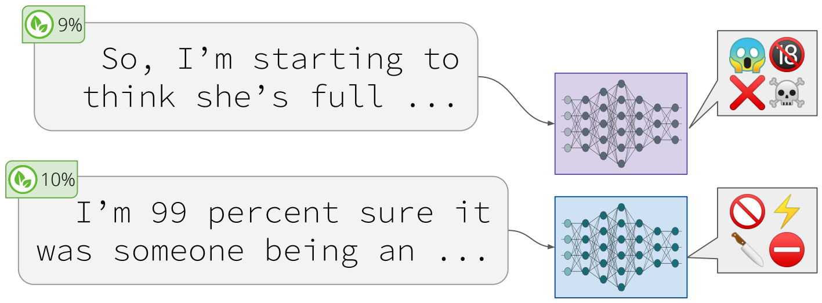
Ml and nlp research highlights of 2020
Practical concerns of large LMs
What happened? Compared to 2019 where the analysis of language models (LMs) mainly focused on the syntactic, semantic, and world knowledge that such models capture—see (Rogers et al., 2020) for a great overview—recent analyses revealed a number of practical concerns. Pre-trained language models were found to be prone to generating toxic language (Gehman et al., 2020) and leak information (Song & Raghunathan, 2020), to be susceptible to backdoors after fine-tuning, which let an attacker manipulate the model prediction (Kurita et al., 2020; Wallace et al., 2020), and to be vulnerable to model and data extraction attacks (Krishna et al., 2020; Carlini et al., 2020). In addition, pre-trained models are well known to capture biases with regard to protected attributes such as gender (Bolukbasi et al., 2016; Webster et al., 2020)—see (Sun et al., 2019) for an excellent survey on mitigating gender bias.
Why is it important? Large pre-trained models are trained by many institutions and are actively deployed in real-world scenarios. It is thus of practical importance that we are not only aware of their biases but what behaviour may have actually harmful consequences.
What's next? As larger and more powerful models are developed, it is important that such practical concerns as well as issues around bias and fairness are part of the development process from the start.

Slide 20
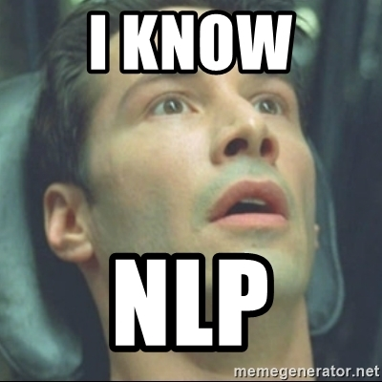
Concluzii
NLP is no longer the future. It’s already here! And it will only grow.

Slide 21
Bibliografie
Lee, A. (2019, November 24). Why NLP is important and it’ll be the future — our future. Retrieved May 4, 2021, from Medium website: https://towardsdatascience.com/why-nlp-is-important-and-itll-be-the-future-our-future-59d7b1600dda
Starbridge Partners. (2020, January 22). The Future of Natural Language Processing - Starbridge Partners. Retrieved May 4, 2021, from Starbridge Partners website: http://starbridgepartners.com/2020/01/the-future-of-natural-language-processing/
Ximena Bolaños. (2020, December 9). Natural Language Processing and Machine Learning. Retrieved May 4, 2021, from Encora website: https://www.encora.com/insights/natural-language-processing-and-machine-learning
Natural Language Processing (NLP) Simplified : A Step-by-step Guide. (2021). Retrieved May 4, 2021, from Datascience.foundation website: https://datascience.foundation/sciencewhitepaper/natural-language-processing-nlp-simplified-a-step-by-step-guide
Pistoia Alliance. (2019). NLP & ML Webinar. Retrieved May 4, 2021, from Slideshare.net website: https://www.slideshare.net/pistoiaalliance/nlp-ml-webinar
Bitext. (2019). Natural Language Processing (NLP) vs. Machine Learning. Retrieved May 4, 2021, from Bitext.com website: https://blog.bitext.com/natural-language-processing-vs-machine-learning#ML
NLP, AI, and Machine Learning: What’s The Difference? (2020, June 9). Retrieved May 4, 2021, from MonkeyLearn Blog website: https://monkeylearn.com/blog/nlp-ai/
Machine Learning (ML) for Natural Language Processing (NLP) - Lexalytics. (2020, September 29). Retrieved May 4, 2021, from Lexalytics website: https://www.lexalytics.com/lexablog/machine-learning-natural-language-processing#ml-vs-nlp
Five AI Technologies. (2021). Retrieved May 4, 2021, from Sas.com website: https://www.sas.com/en_us/insights/articles/analytics/five-ai-technologies.html
Artificial Intelligence – What it is and why it matters. (2021). Retrieved May 4, 2021, from Sas.com website: https://www.sas.com/en_us/insights/analytics/what-is-artificial-intelligence.html
Hira Saeed. (2016, November 4). Developing a Chatbot? Learn the Difference between AI, Machine Learning, and NLP. Retrieved May 4, 2021, from Medium website: https://chatbotslife.com/developing-a-chatbot-learn-the-difference-between-ai-machine-learning-and-nlp-40a3f745aec4
Badreesh Shetty. (2018, November 24). Natural Language Processing(NLP) for Machine Learning. Retrieved May 4, 2021, from Medium website: https://towardsdatascience.com/natural-language-processing-nlp-for-machine-learning-d44498845d5b

Slide 22
Vă Mulțumesc pentru Atenție!

